Slide 1
Predicting House Price
in King County, USA
Regression Project - Daniel & Oz

Slide 2
The Use Case
Model Purpose:
Classify the health of a fetus as Normal, Suspect or Pathological using CTG data
Dataset Overview:
Dataset contains house sale prices for King County, which includes Seattle between May 2014 and May 2015.
# of observations 21,610.
# of columns 21 (such as: sqft living, building grade, num of bedrooms, num of bathrooms etc).
Dataset source:https://www.kaggle.com/harlfoxem/housesalesprediction

Slide 3
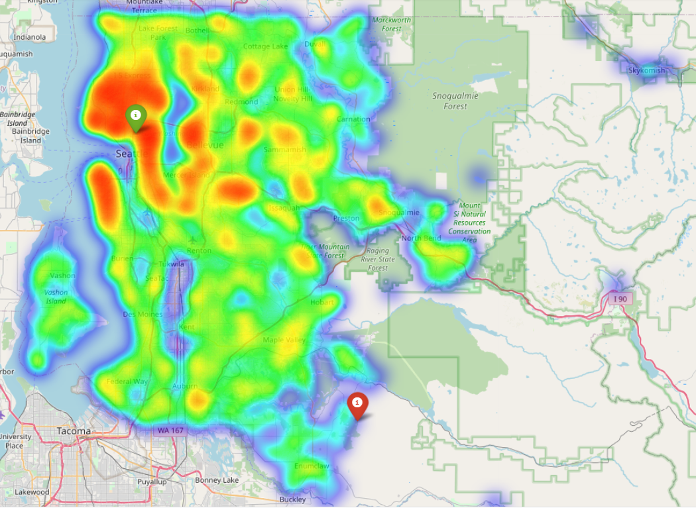
EDA - Location based price heatmap
The most expensive house sold for 7.7 Million $
Seattle
Bellevue
The least expensive house sold for 78K$
House prices are the highest in the north-eastern section of the county (which includes Seattle and Bellevue the two biggest cities of the county).

Slide 4
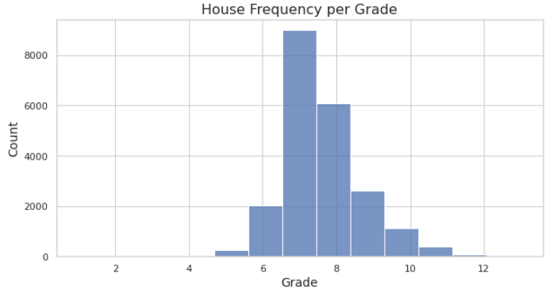
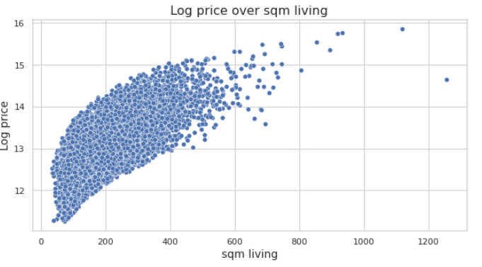
EDA - Grade Distribution and price per sqft living
House prices are increasing with the house size (sqft_living)

Slide 5
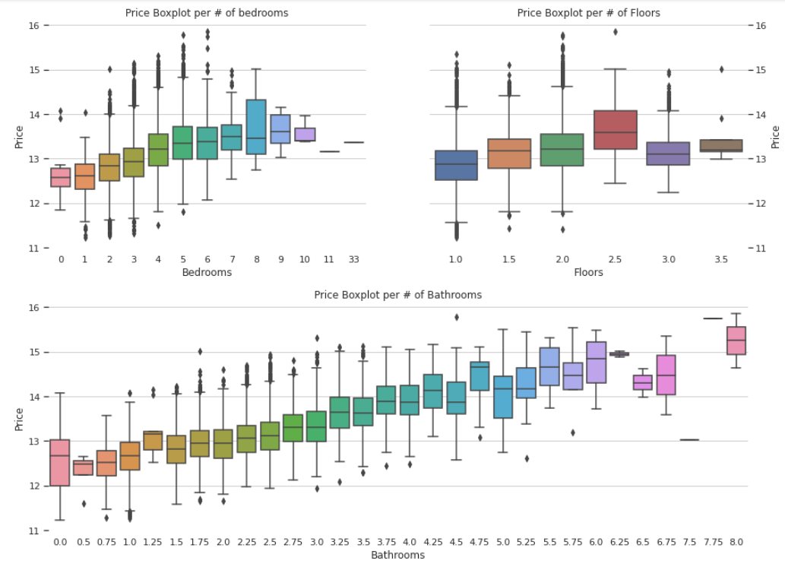
EDA - Feature Visualisations

Slide 6
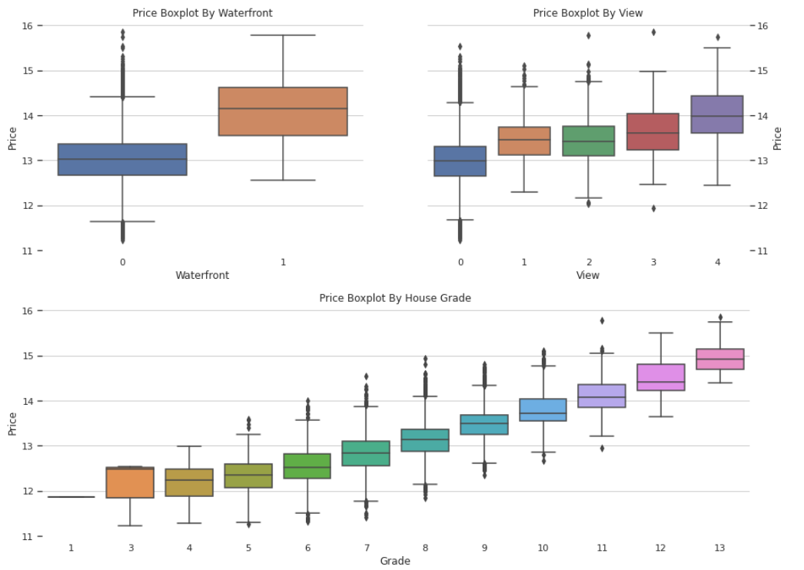
EDA - Feature Visualisations
Executive summary:
The most important features of a house are
Its location
The building grade
The House size
Some other less important features are:
The house view
Number of bedrooms
Number of bathrooms

Slide 7
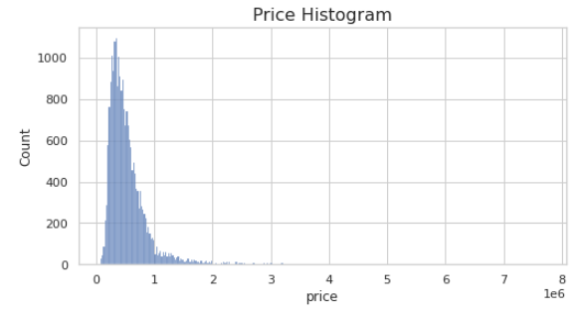
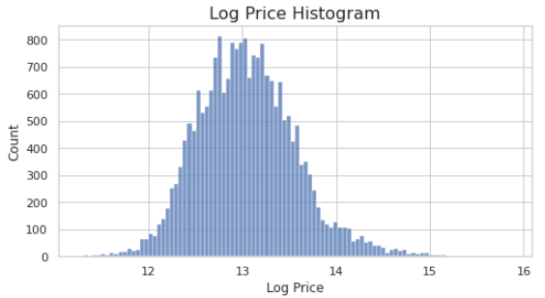
Exploratory Data Analysis (EDA)
Price
Log of price distribution in normal
The Mean price in around 0.5M$
Price Distribution has a long right tail

Slide 8
Data Cleaning
Using the EDA we found:
One house with 33 bedrooms with a size of 3-4 bedrooms (corrected to 3).
13 houses with 0 bedrooms (removed from dataset).
7 houses with up to 0.5 bathrooms (removed from dataset).

Slide 9
Feature Engineering
Added the following features:
Giving time a value - Months passed from the first date till the current date
Convert sqft to sqm - switching from feet metric to meters
Finding the house age - subtracting the year the house was built from the year it was sold
Giving value to renovation - we decided to group houses which were renovated in the last 10 years as a group
Data Enrichment - using an api we’ve added Income and demographic information about the houses. http://www.justicemap.org/

Slide 10
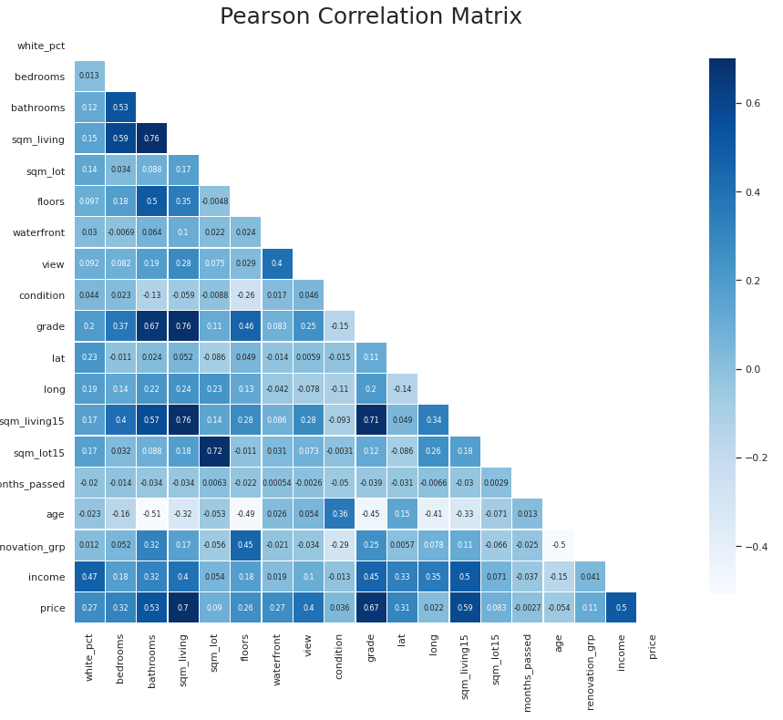
Feature correlation matrix (pearson)
Features with more than 0.5 correlation with price:
Sqm_living vs price - 0.7
Grade vs price - 0.67
Sqm_above vs price - 0.59
Income vs price - 0.51
Bathrooms vs price - 0.53
Sqm_living15 vs price - 0.59

Slide 11
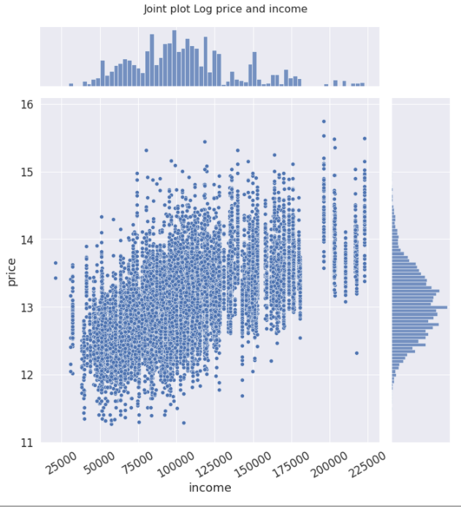
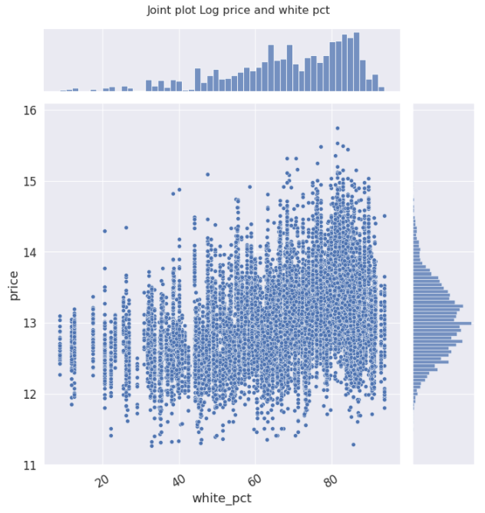
Data Enrichment

Slide 12
Regression Models
1st model Benchmark model:
Simple linear regression
Price = a + b*sqm_living
Multi Linear regression (y log)
Log Price = a + b*X
Decision Tree 🌲
Train :
RMSP error : 50.3%
RMSE: 257.6K
Test :
RMSP error: 51.4%
RMSE: 272.8K
Train :
RMSP error: 25.9%
RMSE: 185.9K
Test :
RMSP error: 25.9%
RMSE: 170.4K
Train :
RMSP error: 19.2%
RMSE: 111.6K
Test :
RMSP error: 24.1%
RMSE: 155.6K
Running a simple linear regression model of (price = a + b*sqm_living ) to get an initial accuracy benchmark to beat
Using a more complex models (Decision Trees & Random forest) with optimized Hyper-parameters using a custom made function to find the minimum rmsle

Slide 13
Regression Models
Random Forest (🌲*100)
Sqm_living Ratio
Price / sqm_living + RF
Grade Ratio
Price / grade + RF
Train :
RMSP error: 16.6%
RMSE: 122.2K
Test :
RMSP error: 19.8%
RMSE: 141.8K
Train :
RMSP error: 16.4%
RMSE: 106.5K
Test :
RMSP error: 19.3%
RMSE: 118.0K
Train :
RMSP error: 16.0%
RMSE: 112.2K
Test :
RMSP error: 19.0%
RMSE: 131.4K
Label engineering - we attempt to predict price per sqm and price per house grade
We compare the results of predicting the price and the Log price

Slide 14
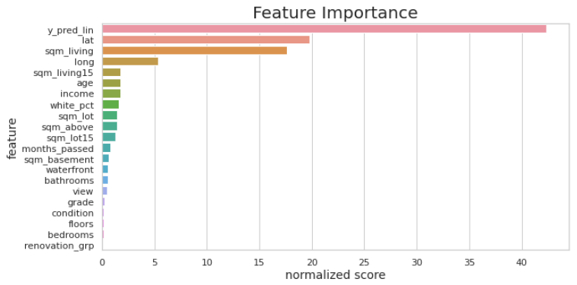
Regression Models
Sqm_living Ratio
Train :
RMSP error: 15.7%
RMSE: 104.8K
Test :
RMSP error: 18.6%
RMSE: 119.6K
With added feature:
y^ ~ multi linear reg
per sqm_living
Train :
RMSP error: 15.46%
RMSE: 105.5K
Test :
RMSP error: 18.46%
RMSE: 118.8K
Grade Ratio
Model engineering - we merge the predictions of two models:
Price per sqm
Price per house grade
Further enhancing our features we use predicted price from linear regression as a feature in our previous model

Slide 15
conclusions
Selected model
Our most accurate model was combining two models :
grade ratio
sqm living ratio model
With added feature : house sale price, predicted using linear model divided by sqm living)
Validity
Our model test and train rmsep differs by 3% which looks quite valid
Keeping our model simple
We tried to keep the model as simple as possible, reducing features which did contributed
Removing the predicted price as a feature would not affect the accuracy by a substantial amount and would keep the model a bit simpler
Items we didn't get to do
Find a more sophisticated way to calculate the predicted price using the final model
Play a bit with some of the less important features to make them more compelling in the model

Slide 16
conclusions
Changes in our model and their effect on accuracy | improved | No change | reduced
Random Forest | ✅
Log Price |  | ✅
Price/sqm_living | ✅
price/grade | ✅
Linear regression predicted price as a feature | ✅
Removing outlier houses |  |  | ✅
Removing least important features |  |  | ✅

Slide 17

Thank you.

